Slide 1
Issaquah Special Education PTSA
An overview of Special Education and Section 504

Slide 2
About Us
The only district-wide PTSA in Issaquah
We serve students ages 3-21 and their families
We support ALL students with disabilities, including those who receive support through an IEP, 504 plan, MTSS, LAP/Title 1, etc
We support staff that work in Special Services throughout the district
We support school PTSAs and are here to partner and support them in their work

Slide 3
Mission Focused
Our mission is to build community, empower families, and advocate for students with disabilities in the Issaquah School District.

Slide 4
An overview of Special Education and Section 504
IEPs and 504s are often used interchangeably to refer to students needing extra support.
While the way they support students may seem similar, they each stem from different federal laws.

Slide 5
IDEA - the law that established Special Education
IDEA established the right to an appropriate education for ALL children.
IDEA defined special education as “specially designed instruction … to meet the unique needs of a child with a disability.” This is called an Individualized Educational Program or IEP.

Slide 6
About Section 504
These plans are covered under Section 504 of the Rehabilitation Act from 1972—a federal civil rights law that protects students from disability discrimination.
Section 504 is a precursor to the Americans with Disabilities Act of 1990.

Slide 7
What do you do if you suspect your child has a disability?
If you suspect there is an undiagnosed disability you need to request a Guidance Team Meeting.
This request should be sent in writing (email is fine) to your child’s teacher, principal, school psychologist and school’s special education teacher.
Keep records of your correspondence and copies of all documentation.

Slide 8
Why seek help for a high school student?
Twice Exceptional or 2E students.
Students with undiagnosed learning disabilities can impact their mental and emotional health.
Proper diagnoses can help with decision making on life after high school.
which school or career path to pursue
help in testing accommodations
Students with IEPS and 504s can access support in college

Slide 9
Your partner in your family’s special education journey
Issaquah Special Education PTSA is here to help!
Parent Power Hours—offered twice monthly
Facebook Group
Website resources
Email us with questions!

Slide 10
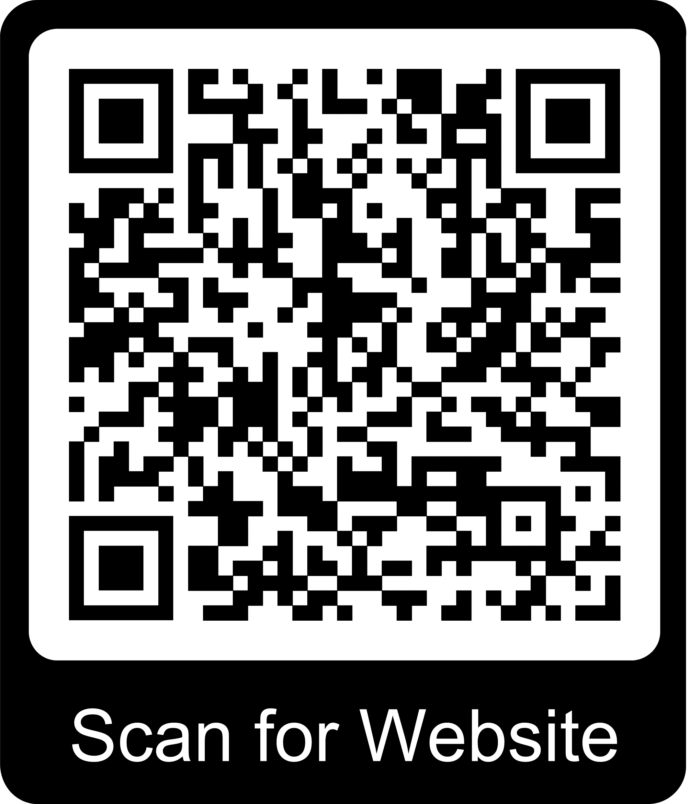
Questions?
How you can you support our work
Join as a member today!
Help us reach special education families
Spread the word!
www.issaquahspecialeducationptsa.org
Thank you.

